Slide 1
Study of international travel
Kendall Cappel

Slide 2
Honors study tours (2013-2014)
United States of America
Kissimmee, Florida
New York City
Appalachia
Italy
Rome
Scotland
Edinburgh
Mexico
Riviera Maya
United Arab Emirates
Dubai
Brazil
The Amazon
The UK
London
France
Normandy
Overall, 1300 students university-wide

Slide 3
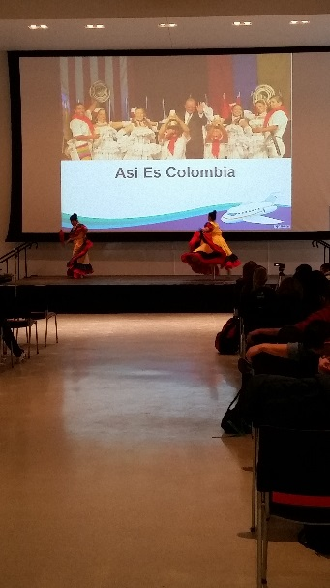
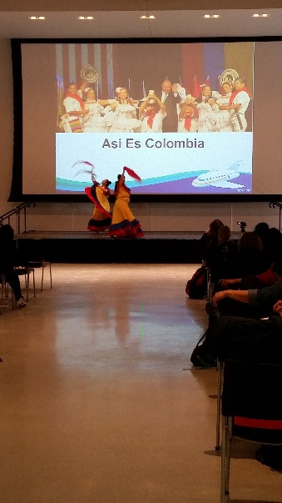
Worldfest opening ceremonies
Received a WorldFest drawstring bag
Chose to visit the Indian food station
Foods: chicken fried rice, tofu with teriyaki sauce, spring rolls, and pad thai
Chicken fried rice tasted like a typical American fried rice
Spring rolls were herbal
The tofu was delicious
Watched the Asi Es Colombia dance
Pictures
Sarah and I took pictures at the WorldFest photo booth

Slide 4
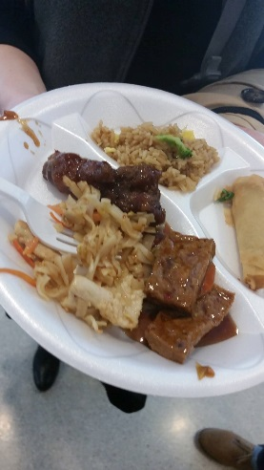
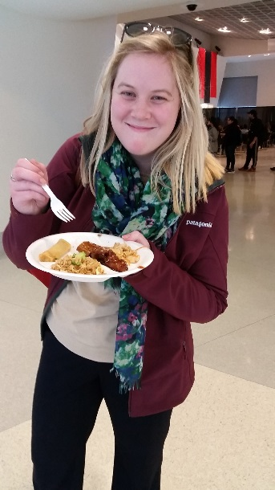
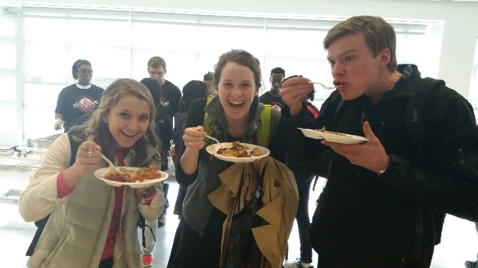
Worldfest opening ceremonies: food
Tofu dish - delicious! Had great taste - took on the sauce, maybe teriyaki? Good texture.
Pad Thai - interesting mix of flavors - chicken, peanut, lime zest. The noodles were great!
Fried rice - had good flavor, but was definitely the most Americanized food that I tried. I like fried rice, and it's a pretty safe dish for anyone who has never tried Chinese food before

Slide 5
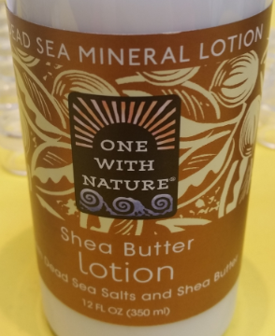
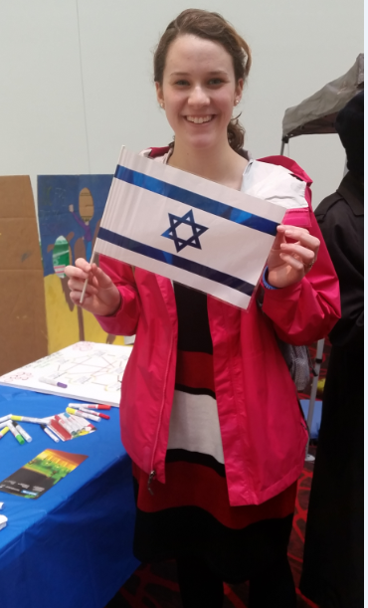
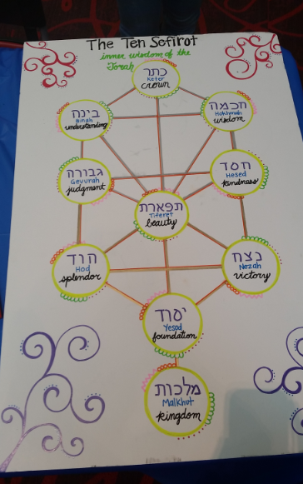
Explore Israel
The Dead Sea has so much salt that a swimmer automatically floats
Was given a sample of shea butter lotion made from the Dead Sea Minerals
The Ten Sefirot
The forces that intervene between you and God
You can move along any path; you can return to something in the past
Everyone takes a different path
Try to achieve your own ultimate crown

Slide 6
Welcome to a dreamer’s reality
Laura Mendez Ortiz
Bogota, Colombia
Traveled to US when she was four years old (undocumented)
Came on a travel Visa that expired within a year
Hopes to become a US citizen
Drove without a license
If caught, deported
In the DECA program
Darwin T. Turner Scholar
“Undocumented students” = illegal
When they do so many other things in their lives, you can’t just look at it as illegal

Slide 7
Welcome to a dreamer’s reality
Jose Cabrera
Born in Mexico
Lived in a house made of aluminum and was “dirt poor”
Ground was the floor
Sick when he was born, living in poverty
At four years old, he crossed into the US
Learned English to defend himself
Father walked out on family at 8 years old
Began couch surfing when he was evicted
“I was the reason white people hate us”
3.6 GPA with first honors at Xavier University

Slide 8
Welcome to a dreamer’s reality
1-3% of undocumented students graduate
UC is very quiet about undocumented students
Work to make UC more inclusive
In one year they don’t know what the election will do to DECA

Slide 9
Folklores from india
Birth
Poverty is an issue in India
People are forced to make weddings a big thing, or will be judged
According to old Indian families, girls are an expense when they come to age
People would abort their girls
Led to many riots in India
Law came about where they couldn’t determine the sex before the birth
Law is still in place

Slide 10
Folklores from india
Marriage
Arranged marriages
Girl family have duty to find a boy
The girls parents talk to boy parents first
All happens before girl meets boy
Olden days – met on wedding day
Super low divorce rate (10 years ago)
Today, not as many arranged marriages (and there are more divorces)
60-70% still have arranged marriages
Parents are proud to get to choose the husband, and give the bride and groom 2-3 months to prepare
Big budget for weddings
Family who makes $100,000 a year, will budget $100,000 for the wedding

Slide 11
badminton
History
Originated in Asia and Europe’s ancient civilizations and was played as an upper-class pastime
Originally called battledore and shuttlecock
Traveled to India where it evolved and the British took back to England
Introduced at a party in Gloucestershire, at the Badminton home
The Game
Best of 3 games, played to 21 points
Singles and doubles games
Court is 40 ft x 20 ft with a 5 ft net
Object is to hit the shuttlecock with your racket and have it land in the opponent’s court
The first to reach 21 points win, you must win by 2, and there is a cap of 30 points

Slide 12
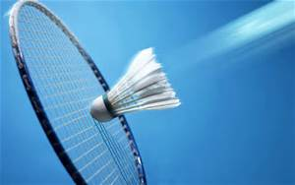
badminton
In the US
Considered a backyard game, not a sport
Tennis is the preferred racket sport in the US
US team didn’t medal at 2008 Olympics, and the US doesn’t like to lose
Contributes to unpopularity

Slide 13
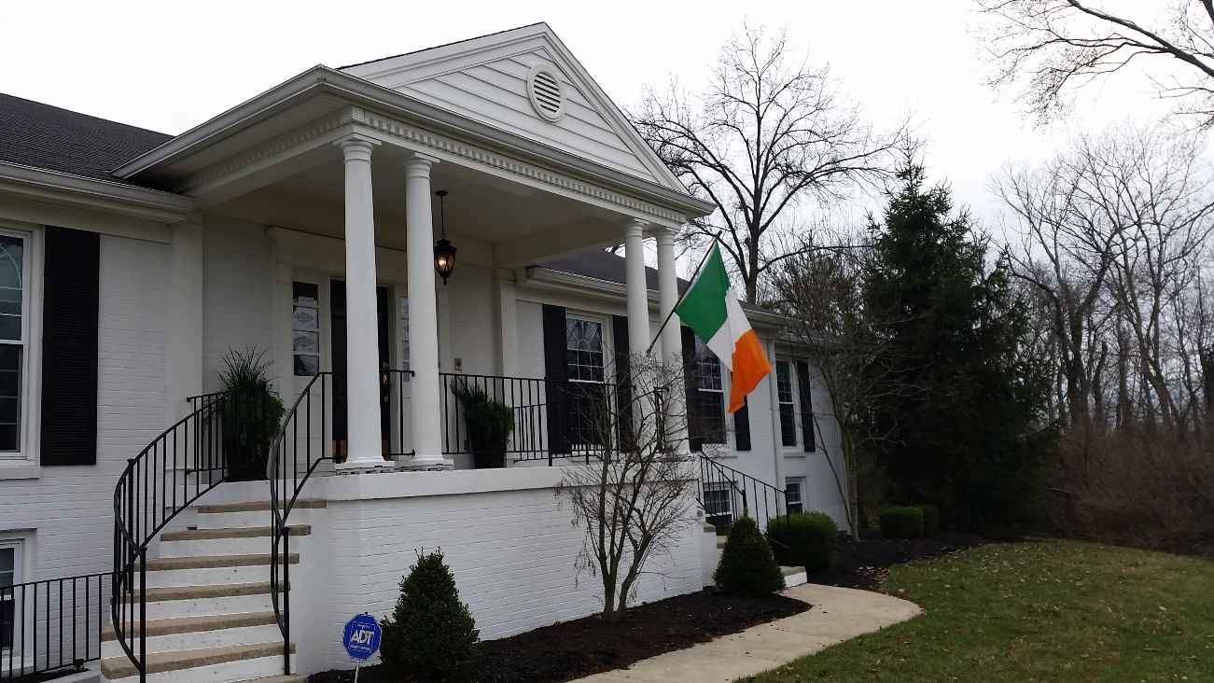
The flag of Ireland
Colors
Green, white, orange
Equal representation
Green
Flown closest to flagpole
Represents Ireland natives (mostly Roman Catholic)
Represents a voice of the people
Stands for the working class during the Easter Rebellion of 1916
White
Hope and peace between the North and South
Can be misconstrued as a division
Orange
Represented Protestants (from England and Scotland) who settled in Northern Ireland
Referred to as “Orangemen”

Slide 14
CultureGrams: Health in Ireland & India
Ireland
Population is healthy
Well-equipped health clinics
Long-term care services are free for people with infectious diseases
Go to private doctors so they don’t have to wait to see a government doctor
India
Poverty, malnutrition, poor sanitation cause diseases such as typhoid and malaria
Working to teach about sanitation and nutrition
Lack of clean drinking water
Government-run hospitals are often short on doctors and drugs
Preventative care is lacking

Slide 15
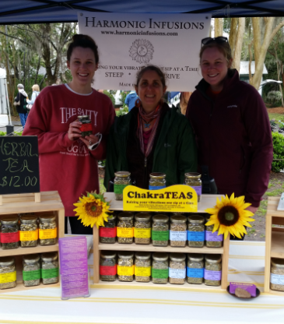
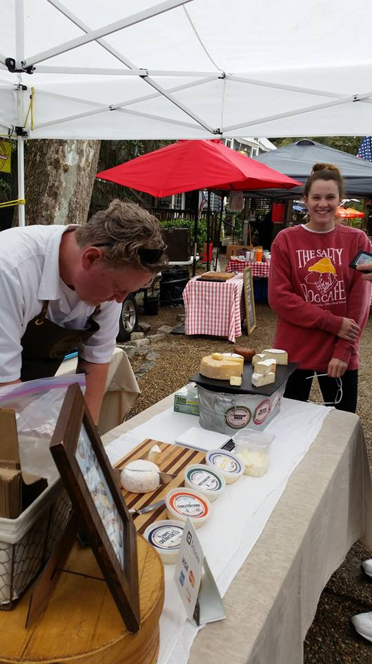
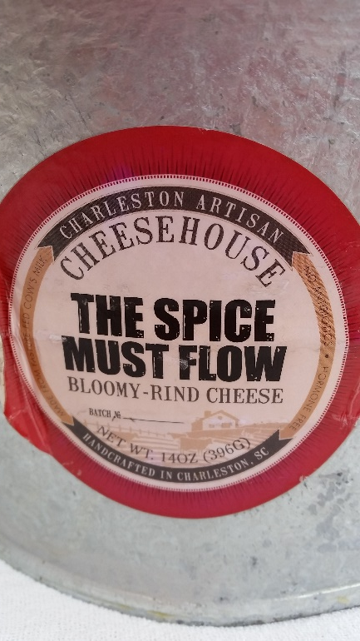
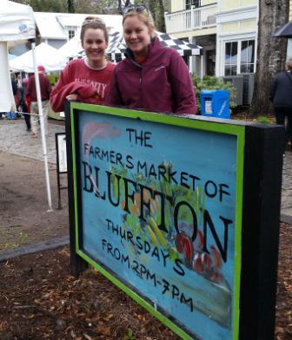
Bluffton Farmers Market
Connect with farmers, growers, craftsmen
Thursdays in Bluffton, SC
Southern Jams
Homemade jams, jellies, chutneys
Proud of her creations
Wouldn’t sell me her product
Charleston Artisan Cheesehouse
Homemade from local ingredients
No hormones
Sampled the Wild Boar (with truffles)
Frommer’s Natural Foods
Local, natural ingredients
Nut-free mix was available
Pre-order so they can make it before the nut mixes
Harmonic Infusions
Chakra teas with organic and wild crafted herbs
“awaken the spirit within our souls”
Tried the Harmony Blend
Dandelion, hibiscus, nettles, rosehips

Slide 16
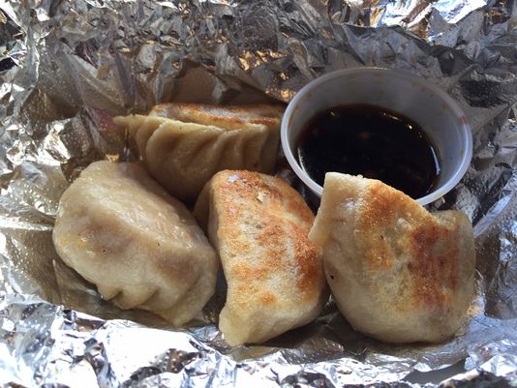
Tiger Dumpling
$5 for 5 dumplings – vegetarian or pork (steamed or potsticker)
Special “tiger dumpling” sauce for dipping

Slide 17
Indian student association
Talked with Sid Thatham (past president)
Began around 2002 at UC
Advisor is Dr. Raj Manglik from Mechanical Engineering
Serves as a support system, alleviate homesickness
Helps to educate the local community with events, traditions
Serve as a resource for new students at UC to find housing, etc

Slide 18
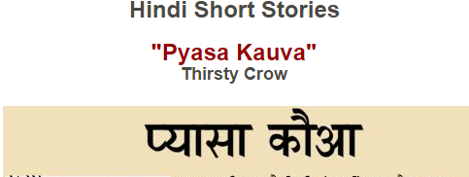
Favorite Story
Talked with Sidhant Chaudhary
First year student from Karnal, India
Encouraged to retain his Hindi language upon arrival in the US
His mother had him read her a story every day in Hindi
The Crow and the Pitcher
The thirsty crow puts pebbles in the pitcher of water to make the water level rise so he could quench his thirst.
He would read the same story aloud to his mother day after day, and after a while, he could recite it from memory!
Moral of the story: Adversity breeds innovation.

