Slide 1
Welcome to Retreat Leader Training!

Slide 2
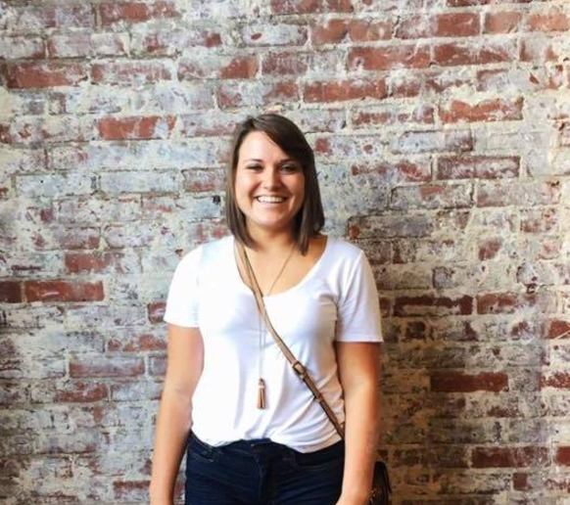
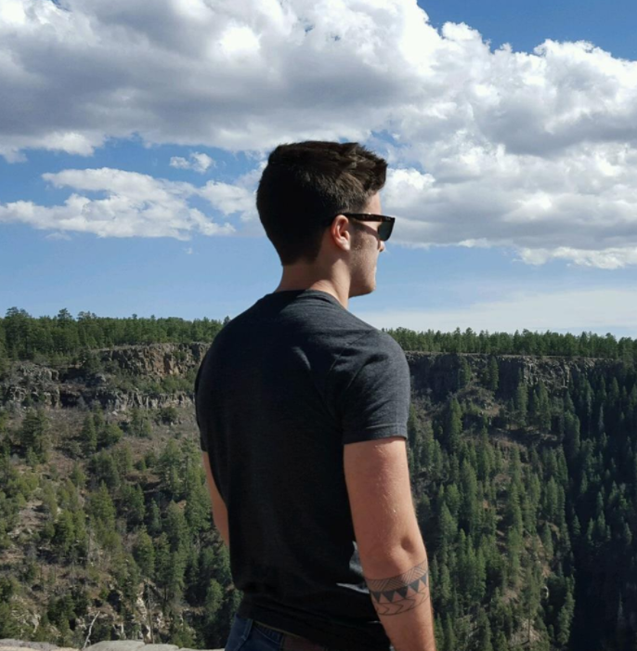
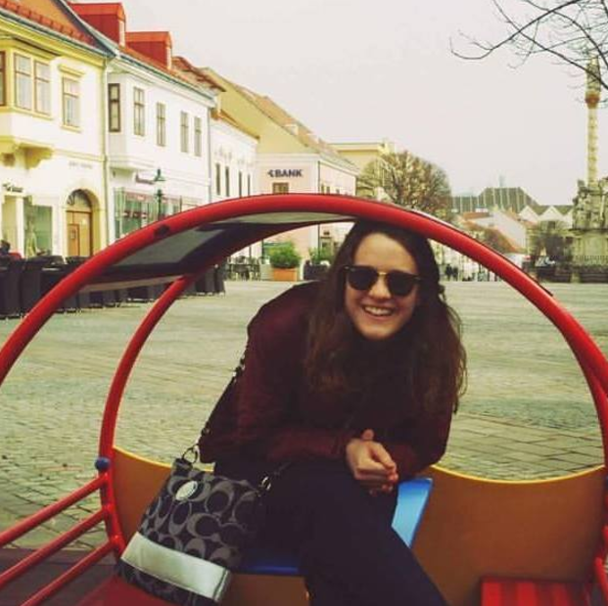
Retreat Coordinator Introductions
Name
Major
Favorite Honors Experience to date

Slide 3
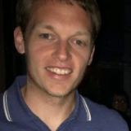
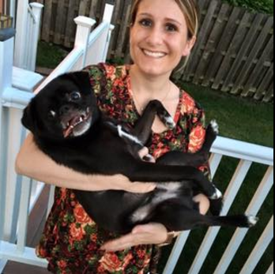
Retreat Staff Introductions
Name
Majors/Colleges you support
Why you are involved with the Honors retreat

Slide 4
Retreat Leader Introductions
Name
Major
Favorite Honors experience to date
One item on your bucket list
IT’S YOUR TURN!

Slide 5
Retreat Nametags
Review logistics of nametags – questions?
T-shirt pass out
Retreat leaders stuff nametags for their group
Split into three groups

Slide 6
Lunch!
Get your burrito and sit with your group!
What would you do? scenarios
How do you manage students who may be quieter in the group?
How do you manage students who are disruptive to the group?
How do you cope with non-participative students throughout retreat?
How do you handle a sickness that may arise?
How do you appropriately address sensitive issues that may come up in group discussions?
Discuss with your team and come up with your best answer to share!

Slide 7
Small Group Time
Get to know you activities!
Over the mountain, two truths and a lie, storybook/movie recreation, introduce your partner, dance move name game, human knot, ninja, rock paper scissors, eye contact circle, pterodactyl

Slide 8
NEW! Skits
Each group prepares 7-8 minute skit to be performed on bonfire night
Themes:
First day of college
Getting involved in college
University Honors experience options
Get ready to showcase in 45 minutes!

Slide 9
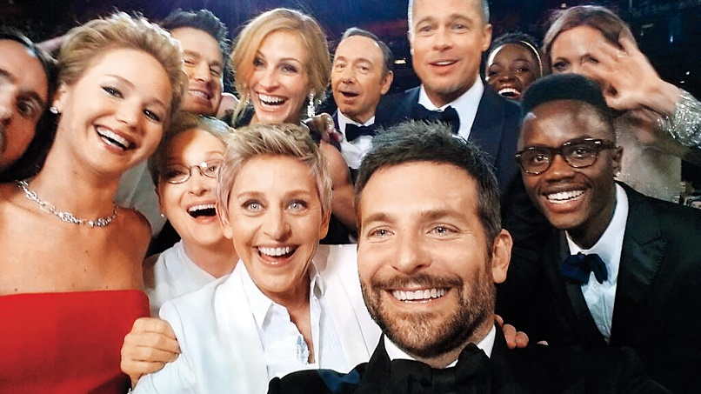
Up Next: Retreat Logistics and Agenda and Other Announcements
But first… GROUP SELFIE

